Slide 1
Testing Theory

Slide 2
Analysing the application
Performance testing does not require as much knowledge of the application as functional testing does.
The tester should have an idea on how the application is actually used in production in order to make an informed estimate.

Slide 3
Defining testing objectives
Determining and recording performance testing objectives involves communicating with the team to establish and update these objectives as the project advances through milestones
Performance, Load or Stress testing: Type and scope of testing should be clear as each type of testing has different requirements.
Goal Setting: General load testing objectives should be defined.

Slide 4
Defining testing objectives
Common Objectives:
Measuring end-user response time
Defining optimal hardware configuration
Checking reliability
Assist the development team in determining the performance characteristics for various configuration options
Ensure that the new production hardware is no slower than the previous release
Provide input data for scalability and capacity-planning efforts
Determine if the application is ready for deployment to production
Detect bottlenecks to be tuned

Slide 5
Defining testing objectives
Stating Objectives in Measurable Terms:
Once you decide on your general load testing objectives, you should identify more focused goals by stating your objectives in measurable terms
To provide a baseline for evaluation, determine exactly what constitutes acceptable and unacceptable test results

Slide 6
Defining testing objectives
For example
General Objective:
Product Evaluation: choose hardware for the Web server
Focused Objective:
Product Evaluation: run the same group of 300 virtual users on two different servers, HP and NEC. When all 300 users simultaneously browse the pages of your Web application, determine which hardware gives a better response time

Slide 7
Gathering requirements
Users
Identify all the types of people and processes that can put load on the application or system
Defining the types of primary end users of the application or system such as purchasers, claims processors, and sales reps
Add other types of users such as system administrators, managers, and report readers who use the application or system but are not the primary users.
Add types of non-human users such as batch processes, system backups, bulk data loads and anything else that may add load or consume system resources.

Slide 8
Gathering requirements
Transactions
For each type of user we identified in the previous step, identify the tasks that the user performs
Production Environment
Performance and capacity of an application is significantly affected by the hardware and software components on which it executes
Speed, capacity, IP address and name, version numbers and other significant information

Slide 9
Gathering requirements
Test Environment:
Should be similar to the production environment as is possible to be able to get meaningful performance results.
It is important that the databases be set up with the same amount of data in the same proportions as the production environment as that can substantially affect the performance.
Scenarios:
Select the use cases to include
Determine how many instances of each use case will run concurrently
Determine how often the use cases will execute per hour
Select the test environment

Slide 10
Gathering requirements
Load test Tool:
Ability to parameterize data.
Ability to capture dynamic data and use on subsequent requests.
Application infrastructure monitoring.
Support for the application's protocols
Load test Lab must include the following:
Test Servers.
Databases.
Network elements, operating systems and clients and server hardware.

Slide 11
Performance Testing

Slide 12
Performance testing
Performance testing is the general name for tests that check how the system behaves and performs.
It examines responsiveness, stability, scalability, reliability, speed and resource usage.
Notes:
What should we compare these measures too?

Slide 13
Performance testing
This is measured in comparison with different versions of the same product or a different competitive product.
Performance testing is done to derive benchmark numbers for the system.
Tuning is performed until the system under test achieves the expected levels of performance.
Different types of performance testing provide different data.

Slide 14
Performance testing goals
Access production readiness
Compare two platform to compare which performs better
Compare performance characteristics of system configurations
Evaluate system against performance criteria
Discover what parts of the application perform poorly and under what conditions
Finding the source of performance problems
Support system tuning

Slide 15
Why is it important?
Most users click away after 8 seconds of delay
£4.4 billion business revenue loss due to poor web applications performance
Aberdeen found that inadequate performance could impact revenue by up to 9%
Business performance begins to suffer at 5.1 seconds of delay in response times of web applications and 3.9 for critical applications
An additional second of waiting on a website significantly impact customer satisfaction and visitor conversions
Page viewers, conversions rate and customer satisfaction drops 11%, 7% and 16% respectively
Notes:
These facts have no sources, but you get the picture.

Slide 16
What could be the damage?
Loss of revenue
Loss of customers
Loss of productivity
Backlog of work
Media attention and damage to your companies brand

Slide 17
Types of performance testing
Load testing
Stress testing
Soak / Endurance testing
Volume / spike testing
Bottleneck (Testing for)

Slide 18
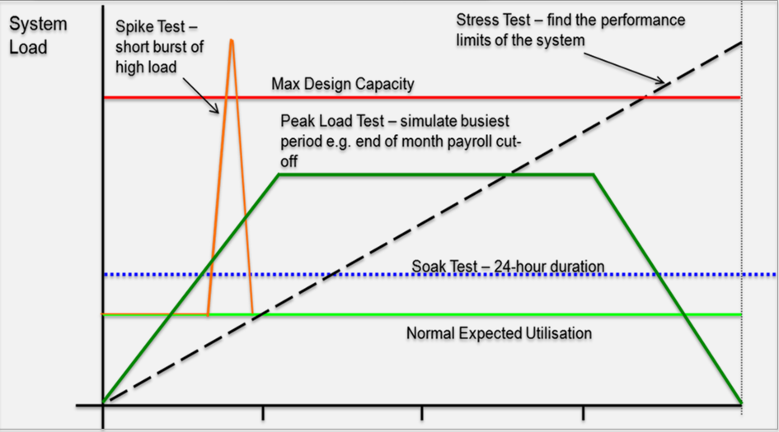
Types of performance testing (cont..)
Time
Notes:
Think back to this graph when we discuss the different types of testing in more detail later.

Slide 19
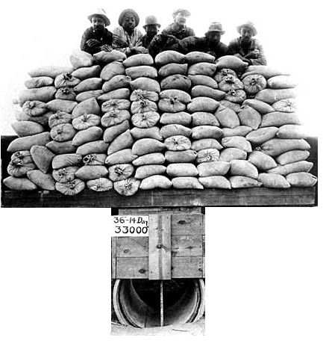
Load testing
Process of exercising the system under test by feeding it the largest tasks it can operate with.
Constantly increasing the load on the system via automated tools to simulate real time scenario with virtual users.
Examples
Testing a word processor by editing a very large document.
For Web Application load is defined in terms of concurrent users or HTTP connections.
Notes:
From this type of testing we can get an idea of how the system will respond in different scenarios.

Slide 20

Stress testing
Trying to break the system under test by overwhelming its resources or by taking resources away from it.
Purpose is to make sure that the system fails and recovers gracefully.
Example
Double the baseline number for concurrent users/HTTP connections.
Randomly shut down and restart ports on the network switches/routers that connects servers.

Slide 21

Endurance / soak testing
This type of testing is used to check that the system can withstand the load for a long or large number of transaction.
Test will be performed with defined set of concurrent users for a prolonged period of time, say for example 5 to 10 hours or 2 to 3 days.

Slide 22

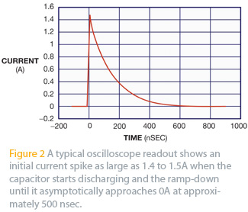
Spike testing
Spike testing is done by suddenly increasing the number of load generated by, users by a very large amount and observing the behaviour of the system. The goal is to determine the performance degrade, system failure or it will be able to handle dramatic changes in load.
Say for example, test will be initiated with 200 concurrent user for a certain period of time, suddenly the concurred user load will be increased to 1000 and the system performance will be monitored. Like wise the user load will be decreased to 200 concurrent users and verify the system returns to normal operation and retaining the performance as initiated.

Slide 23
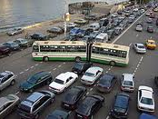
Bottleneck
A bottleneck is a phenomenon where the performance or capacity of an entire system is limited by a single or limited number of components or resources.
Your web application can consist of several modules used to process request. If one of them has technical limitation, it limits the performance of the whole system
Bottleneck in the application can be identified by performing the load test with the defined concurrent user load for various scenarios.

Slide 24
Factors
Throughput
Response time

Slide 25
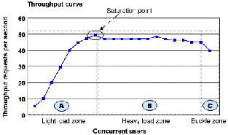
Throughput
Capability of a product to handle multiple transactions in a give period.
Throughput represents the number of requests/business transactions processed by the product in a specified time duration.
As the number of concurrent users increase, the throughput increases almost linearly with the number of requests. As there is very little congestion within the Application Server system queues.

Slide 26
Throughput
In the heavy load zone or Section B, as the concurrent client load increases, throughput remains relatively constant.
In Section C (the buckle zone) one or more of the system components have become exhausted and throughput starts to degrade. For example, the system might enter the buckle zone when the network connections at the Web server exhaust the limits of the network adapter or if the requests exceed operating system limits for file handles.

Slide 27
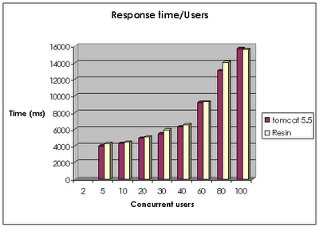
Response time
It is equally important to find out how much time each of the transactions took to complete.
Response time is defined as the delay between the point of request and the first response from the product.
The response time increases proportionally to the user load.

Slide 28
Pre requisites for Performance Testing
Stable build free from all major functional defects
An environment that is similar to the production environment
No other testing should be performed while performance testing is being done
Complete understanding and knowledge of the application under test

Slide 29
Performance testing process
Project Assessment
Planning
Environment Setup
Test Execution
Reporting

Slide 30
Core activities
Identify the test environment
Performance test environment should be the exact replica of the production environment
Identify performance acceptance criteria
Identification of performance testing matrices and acceptable value of each matrix
Plan and design the tests
Identification of user test scenarios based on their importance, frequency and performance impact
Configure the test environment
Test environment setup as identified in an earlier phase

Slide 31
Core activities
Implement the test design
Scripting of user scenarios with the help of a performance testing tool e.g. JMeter
Execute the tests
Execution of scripted user scenarios against different user sets with different configurations
Analyse results, report and retest
Analyse the executed test results with identified matrices, report results to stakeholders and retest if required

Slide 32
Analysing the application
Load testing does not require as much knowledge of the application as functional testing does.
Load tester should have some operational knowledge of the application to be tested.
Load tester should have the idea on how the application is actually used in production to make an informed estimate.
Load tester must know the application architecture (Client Server, Local Deployment, Live URL), Platform and Database used.

Slide 33
Load balancers
A load balancer is a device that acts as a reverse proxy and distributes network or application traffic across a number of servers. Load balancers are used to increase capacity (concurrent users) and reliability of applications.

Slide 34
When should I do performance testing?
Design phase
Pages containing lots of images and multimedia for reasonable wait times. Heavy loads are less important than knowing which types of content cause slowdowns
Development phase
To check results of individual pages and processes, looking for breaking points, unnecessary code and bottlenecks
Deployment phase
To identify the minimum hardware and software requirements for the application

Slide 35
What should be tested?
High frequency transactions
The most frequently used transactions have the potential to impact the performance of all of the other transactions if they are not efficient
Mission Critical transactions
The more important transactions that facilitate the core objectives of the system should be included, as failure under load of these transactions has, by definition, the greatest impact

Slide 36
What should be tested?
Read Transactions
At least one READ ONLY transaction should be included, so that performance of such transactions can be differentiated from other more complex transactions
Update Transactions
At least one update transaction should be included so that performance of such transactions can be differentiated from other transactions

Slide 37
JMeter

Slide 38
Recap of Performance Testing
Testing we have done so far is mainly for functionality – does the system behave as expected given certain parameters
“Does it do what it is supposed too”
Performance testing, which is a non-functional test, is ensuring a good user experience under any user load
To do this we must do 2 things, what might they be?
Notes:
Create the load
And Measure the User Experience

Slide 39
What is JMeter?
JMeter sends HTTP Requests
Server responds
JMeter measures the response
JMeter is not a browser – but can simulate one – or more accurately multiple browsers.
As JMeter is not a browser this means it cannot execute JS or render the page.

Slide 40
What is JMeter?
100% Java desktop application
For Web and FTP, Java, SOAP/XML-RPC, JDBC applications
Benefits:
Open Source
The distributed testing
Various target systems
Extensibility: Pluggable samplers allow unlimited testing capabilities
Drawbacks:
Chart representation quite confusing
Terminology not very clear
Necessary to start remote machine one by one
Remote machines must be declared in a property file before starting application

Slide 41
What is JMeter?
The Principle of JMeter
In order to test an API all you need is the URL and the Request – starting from this you can build more and more complex tests, which are formed in your test plan.

Slide 42
Why use JMeter?
It is an Open source tool.
Can load and performance test many different server types:
Web - HTTP, HTTPS
SOAP
Database via JDBC
LDAP
JMS
Mail - POP3(S) and IMAP(S)
User friendly GUI Design compare to other tools.
Full multithreading framework allows concurrent sampling by many threads and simultaneous sampling of different functions by separate thread groups.

Slide 43
Why use JMeter? (cont..)
Caching and Cookies can be enabled and it impact as such as it is executing in the web browser.
Controllers are configurable and can monitor the server performance.
Test results are more reliable compare to other open source tools.
Test results can be captured in various format like summary report, Graph, Aggregate report, Aggregate graph, Results in tree and Results in Table.

Slide 44
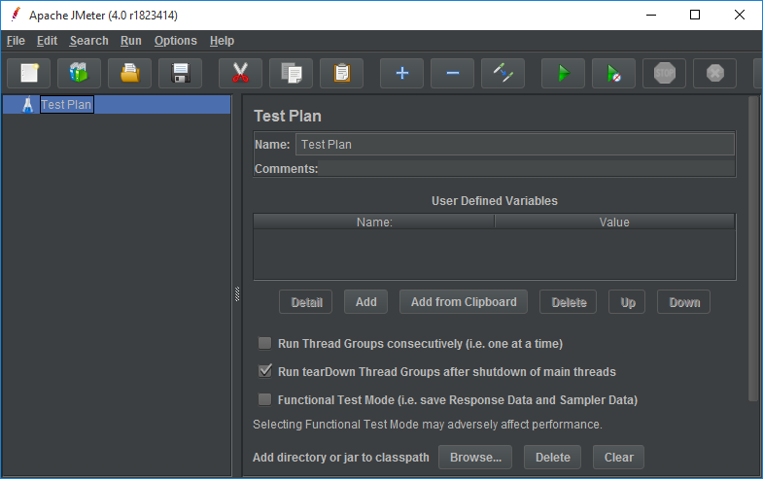
JMeter
Logic of the Scripts goes here – This is the Test Plan
Details of the different steps

Slide 45
Elements of a basic test plan
Thread group
Setup number of threads
Set up ramp up period
No. of times test executes
Controllers
Sampler (send request to server)
Listener
Graph result
View results tree and many other formats
Timers
Delay next request for certain amount of time

Slide 46
Other Elements of test plans
Assertions
Allow you to assert fact about responses received from HTTP request
Configuration elements
Allow you to configure settings
Pre processor
Execute prior to sampler request
Post processor
Execute some action after sampler request

Slide 47
Thread Group
Contains all the elements that JMeter uses to execute the test cases.
Each Thread simulates a real user

Slide 48
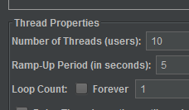
Using JMeter
Add a thread group to the test plan
Configure the this thread group with :
A Name
The ramp-up period
The loop count

Slide 49
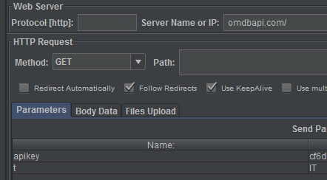
Using JMeter
Add a HTTP Request Sampler to your Thread Group
Configure the IP that you need to test
You can also configure the Path and the Parameters that you would like to send with each test.

Slide 50
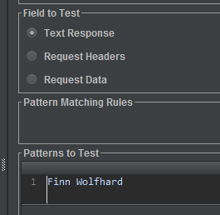
Using JMeter
Add a View Results Tree Listener to your Request to see the results.
You can add a Response Assertion to the request and test for particular patterns, for example, that some particular text appears in the response.

Slide 51
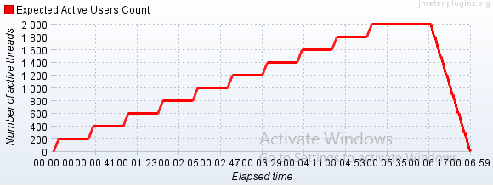
Useful Plugins with JMeter
Search Google for the JMeter plugin Manager
Find jpgc standard set – this plugin contains lots of useful features
Primarily features that will make our results easier to interpret and features that will allow us to make load tests.

